Slide 1
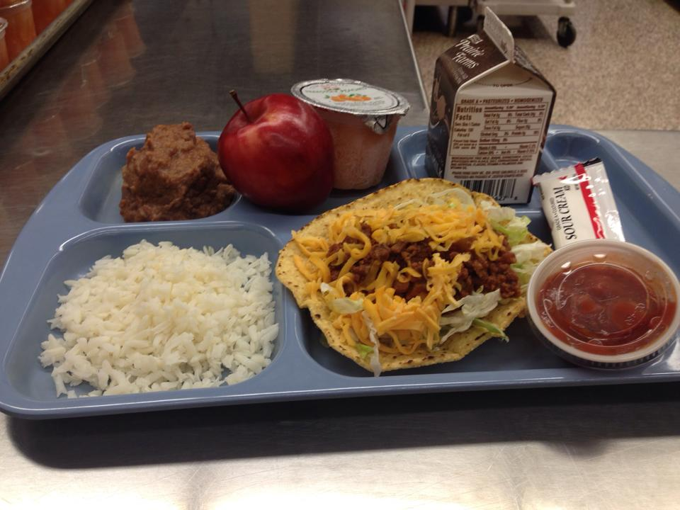
Menu Planning
Southwestern Consolidated Schools Shelby County

Slide 2
About Us:
2 schools
K-6th and 7-12th
10 Nutrition Staff Members, 1 Treasurer, 1 FSD
Approximately 600-650 students
37% Free/Reduced
Serve Breakfast and Lunch
Approximately 73% of students eat reimbursable meals
Another 7-9% choose to eat our ala carte

Slide 3
HOW TO BEGIN MENU PLANNING
Question 1. Are you starting from scratch
or
tweaking an existing menu?
Question 2. SHOULD you start from scratch?

Slide 5
How to begin (continued)
Find a good resource who has had success
Kansas State Department of Education
www.kn-eat.org (resources, Healthier Kansas Menu)
Cycle Menus, Purchasing & Prep/serving instructions, Production records – it is all laid out for you!
Research other schools
Call or email them for recipes – we are all in this together!
Talk to vendors
Ask for samples or tastings (they will come to you and set up at lunch for the students to have a taste test)
Visit food shows and vendor tastings

Slide 7
Cycle Menus
What is the right length of time for a cycle menu?
There is no right or wrong. Some do 3 weeks, some do 4, we have a 6 week cycle.
Reason for 6 week cycle:
When they look at monthly menu there are no repeated days (They perceive it to be a new menu each month)
Plenty of room for adjustments
Not only do the customers stay interested, the cooks do not get as bored.

Slide 8
MENU PRESENTATION
Layout
Can use the same menu and have weeks labeled 1,2,3
Download menus and make a monthly menu each month.
Cut and paste from previous months to just repeat the cycle.
Little extra work, but the perception is it is a new menu

Slide 12
MENU PRESENTATION
Wording
Just because it is whole grain doesn’t mean it has to say it! Put a side bar on the menu that reads
The grains we serve are 50% whole grain.
Which sounds better:
Hamburger on whole grain bun
Straight off the grill… Fresh grilled hamburgers

Slide 13
MENU PRESENTATION
Wording
Appealing and self explanatory
If a menu says Walking Tacos, we put in smaller print under it (Tortilla Chips, Meat, Cheese, lettuce, Tomato)… this gives more details as to what is in a walking taco
If it is Hamburger Cavatini… (like hamburger helper)
Sunday Dinner on Thursdays
Mama Mia that’s Good Pasta Day
Dipping Day
Dip or Mix

Slide 14
The Right Products to go with the Menu
Quality, Variety, & Price
Search. Research. Ask.
Did you know:
3oz Frozen Cooked Chicken Breast = $0.55 each
120 calories, 320mg sodium
3oz Frozen Raw Chicken Breast = $0.51 each
80 calories, 135mg sodium
So many marinades and low sodium spices can be used to change this product up!
Lasagna from semi-scratch = $0.46/serving
Made with JTM frozen spaghetti meat, cottage cheese, commodity mozzarella, lasagna noodles
Frozen Lasagna Roll-Up = $0.66/serving
Add commodity spaghetti sauce

Slide 15
The Right Cooking Method to go with the Right Products
GRANTS! GRANTS! GRANTS!
FUTP60
Dairy Association Equipment Grant
Grill
Does the school have one?
Can they purchase one?
Steamers
Do you have them? Are you using them?
Smokers
Oh the possibilities!
Flat Top Griddles
Is it being used?
Panini Press
Action Stations
My favorite!

Slide 16
Optional Meal
Stations
Larger schools can have multiple stations – don’t forget variety on these stations too (Deli bar, Pizza Bar, Wok, Burger)
Salad Bars
We have a salad bar option daily.
Includes salad fixings, yogurt, cheese sticks, Uncrustables, Deli Sandwiches
Choice Line/Ala Carte
One day a week (Fridays) we have Cook’s Choice on Ala Carte side. Gives cooks a chance to use items in the freezer
Choice Entrée will be menued to use previous day entrée
Example: Meatballs and Mac n Cheese on hot line on Tuesday, Meatball subs on Choice line on Wednesday

Slide 17
Ask – Invite - Encourage
Encourage Feedback!
Good or bad
Parents
Invite parents to eat with students
Put blanket invite in teacher/café newsletters
Have a designated Bring Parent to lunch day
Students
Ask for opinions
Do surveys
Sit and talk with kids
Media
Invite the media to your school!
Special event
General piece on what you are doing in your kitchen that sets you a part from the rest of the schools.
Staff
Encourage staff to eat by offering Staff appreciation lunches or frequent lunch cards

Slide 18
Thank you
Charity Elliott, FSD
Southwestern Consolidated School
celliott@swshelby.k12.in.us
www.swshelby.k12.in.us

