Slide 1
Increasing Meal Participation
Jessica Murray, SNS

Slide 2
West Central School Corporation
District Information
Enrollment: 844
Free & Reduced: 53%
2 Schools
2 Kitchens: K-5 and 6-12

Slide 3
Increasing Participation
*Customer Service
*Presentation
*SNAC
*Menu Selection
*Local Fresh Produce
*Contests/Theme Meals
*Atmosphere
*Excitement FUN

Slide 4
Customer Service
*Friendly Staff
* welcoming
*smiling and communicate
*the customer is the focus
*know where their strengths are and use them
*Student experience
*get to know the students names
*support their efforts (band, drama, sports, academic, etc.)

Slide 5
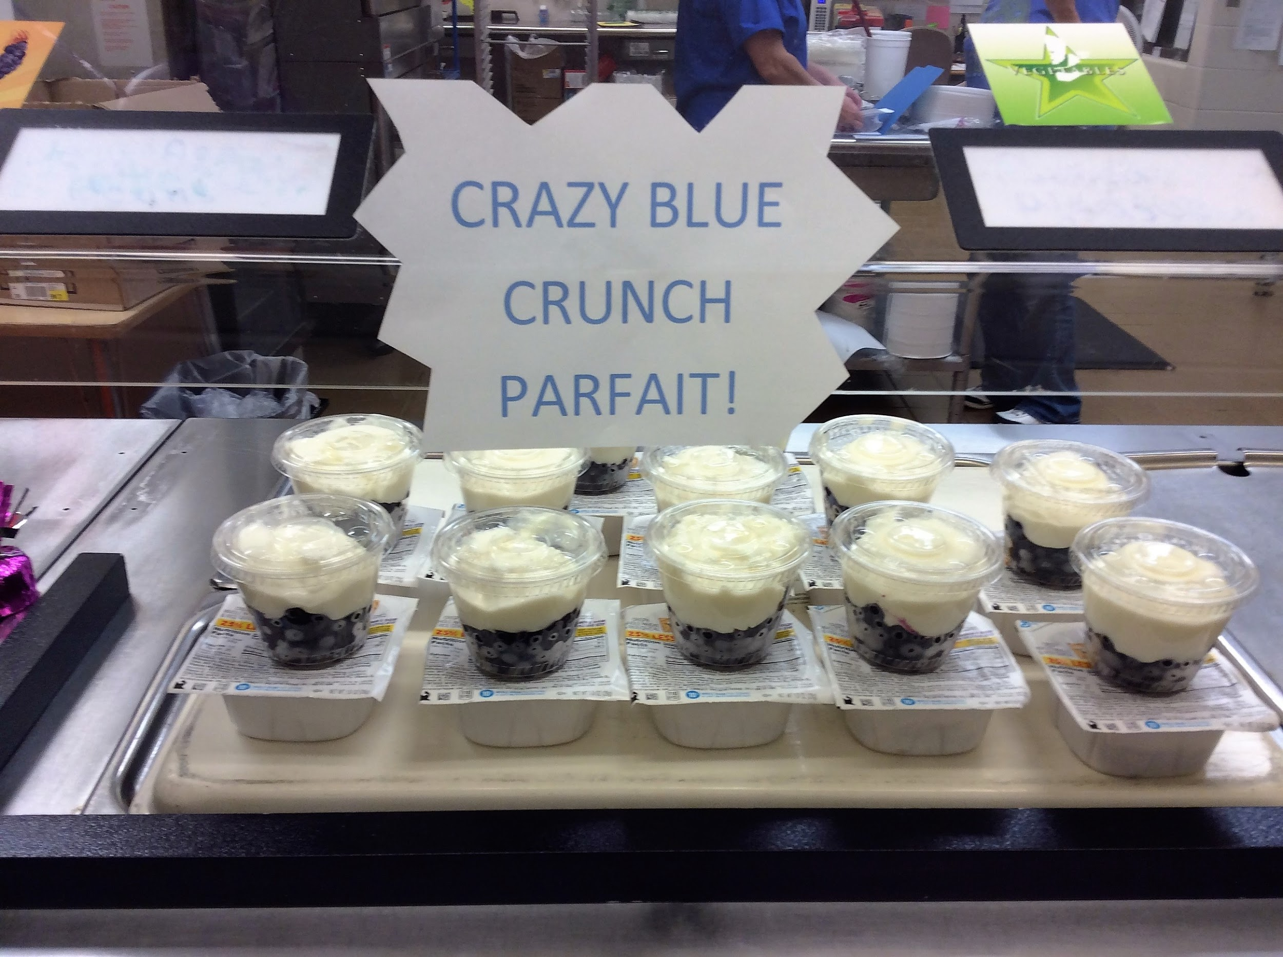
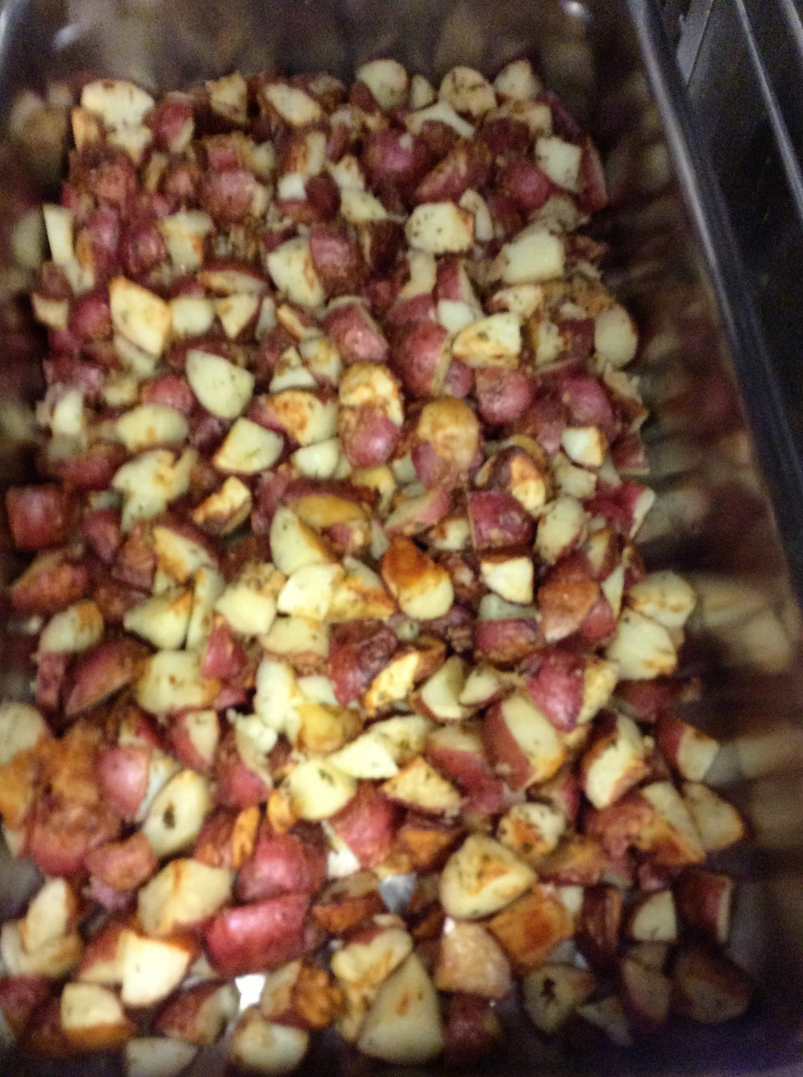
Presentation

Slide 6
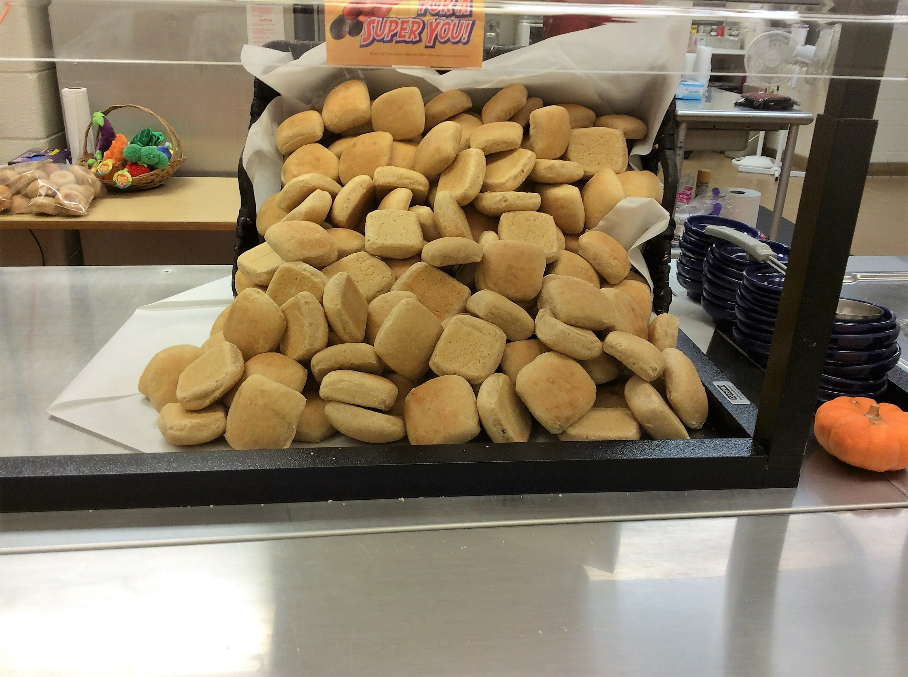
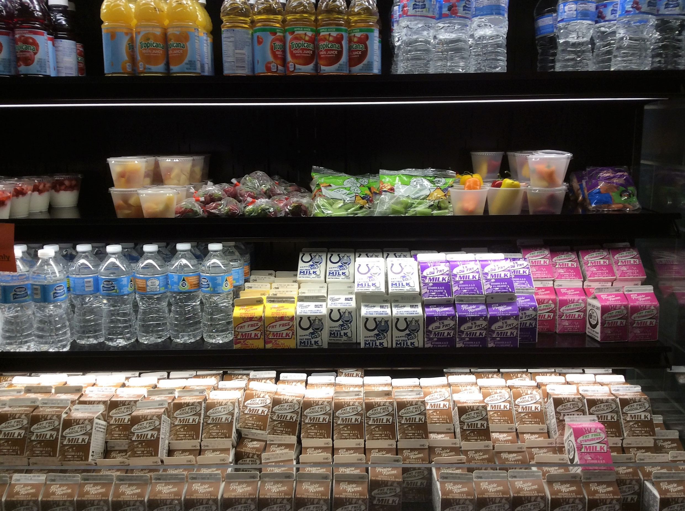
Does it look appealing??
Labels out easy to see what it is

Slide 7
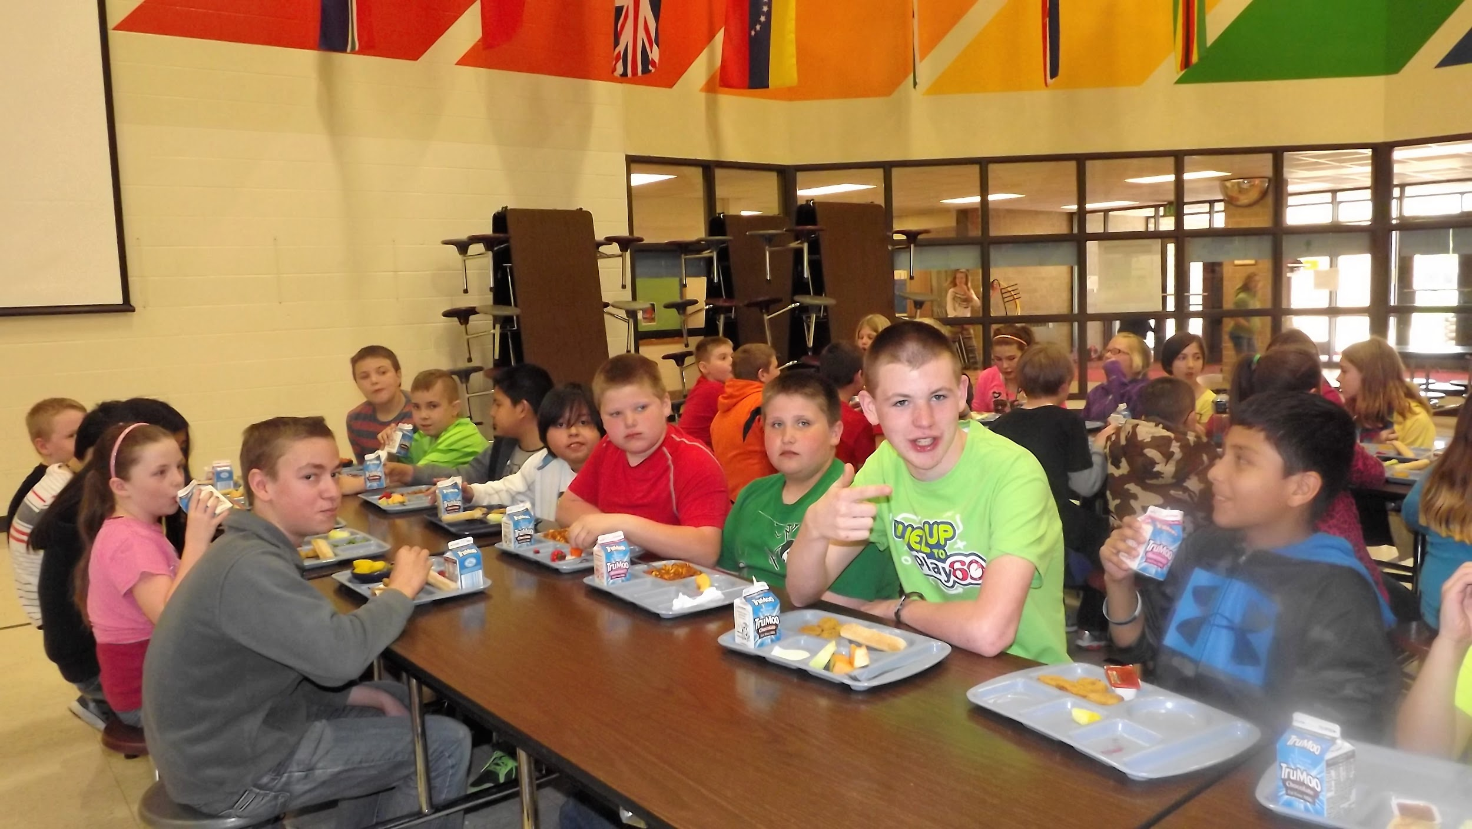
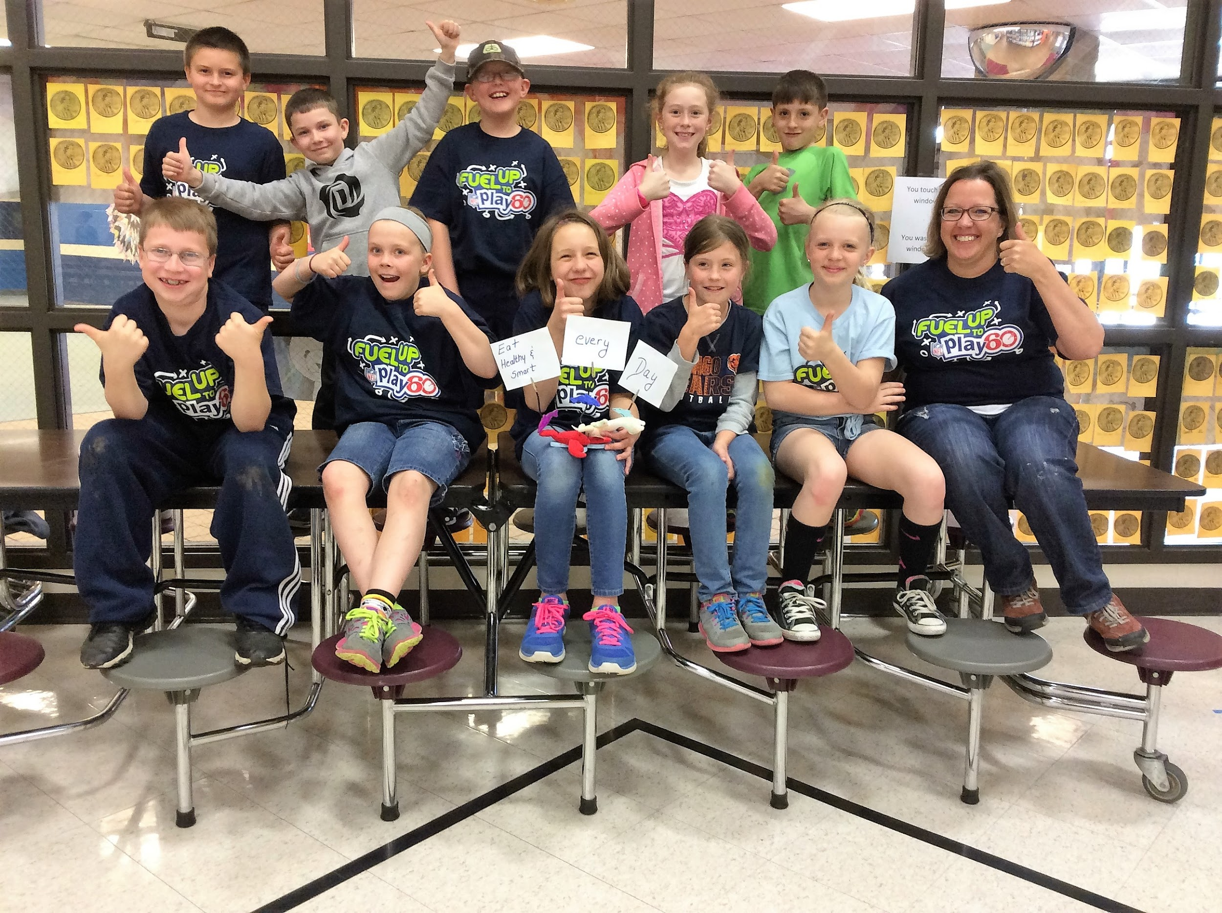
SNAC

Slide 8
Menu Selection/Taste testing
Know what the customer will eat
Do taste testing frequently
Keep up with the current trends in your community/restaurants the students frequent
Look at the numbers and remove the items that have low participation
Serve a variety so everyone can find something

Slide 9
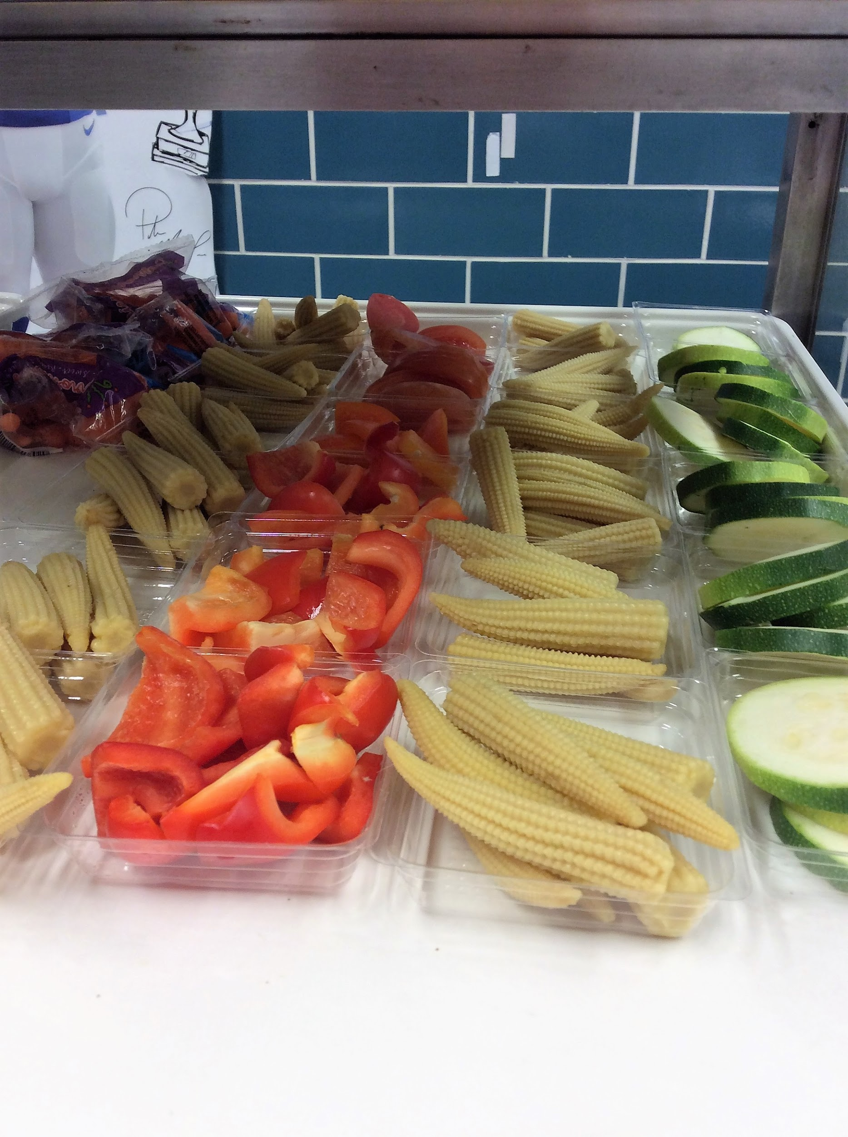
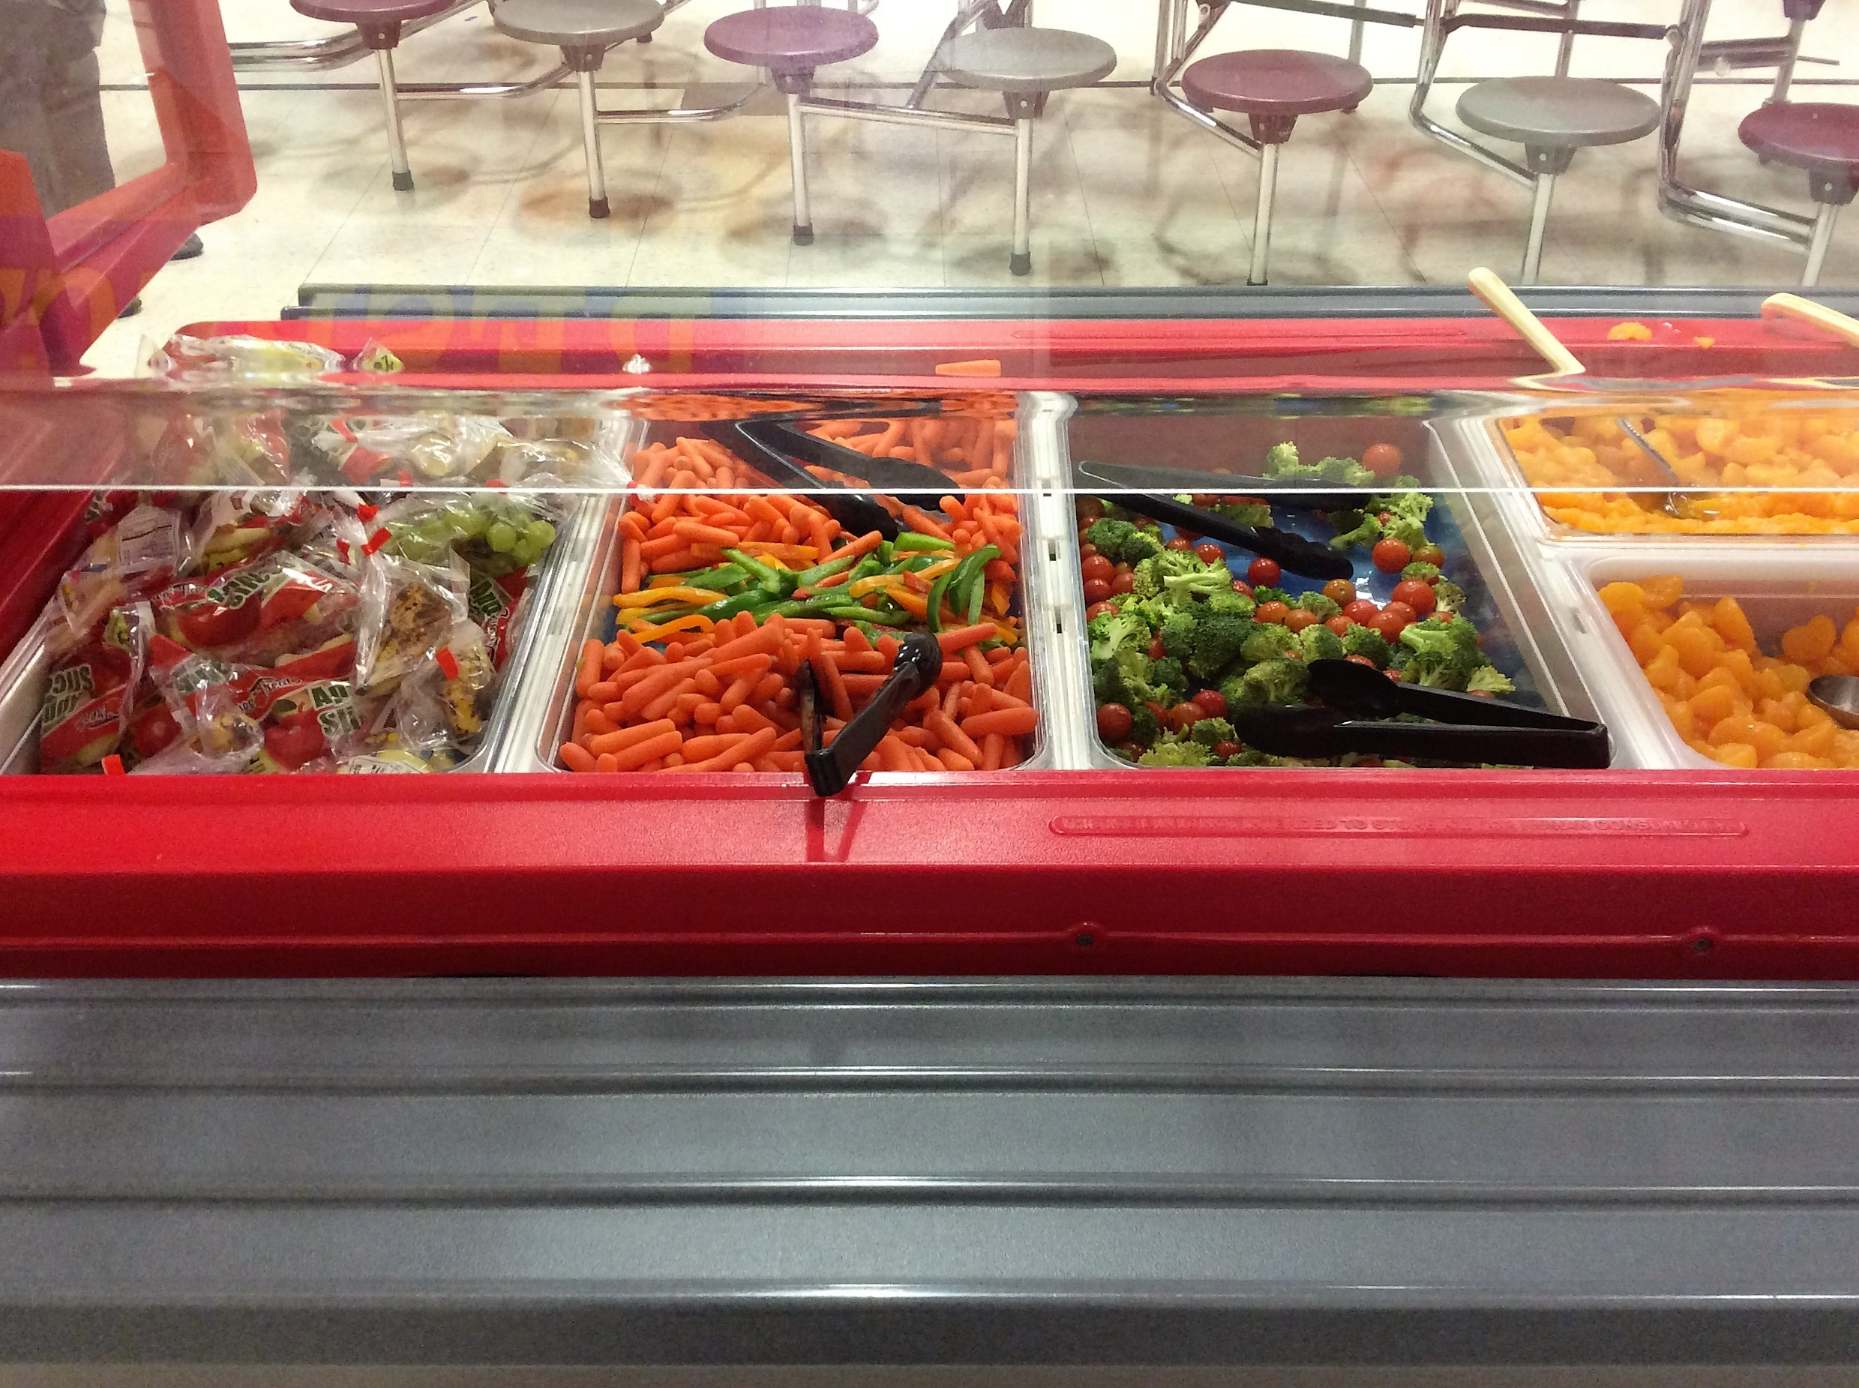
Local Fresh Produce

Slide 10
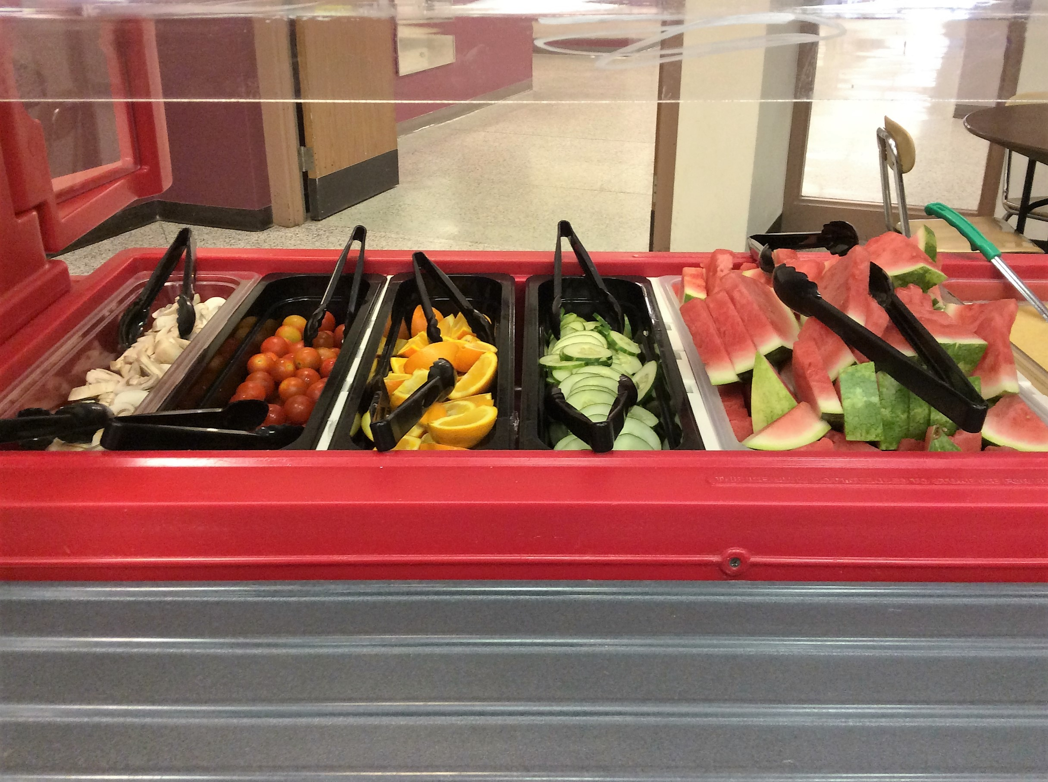
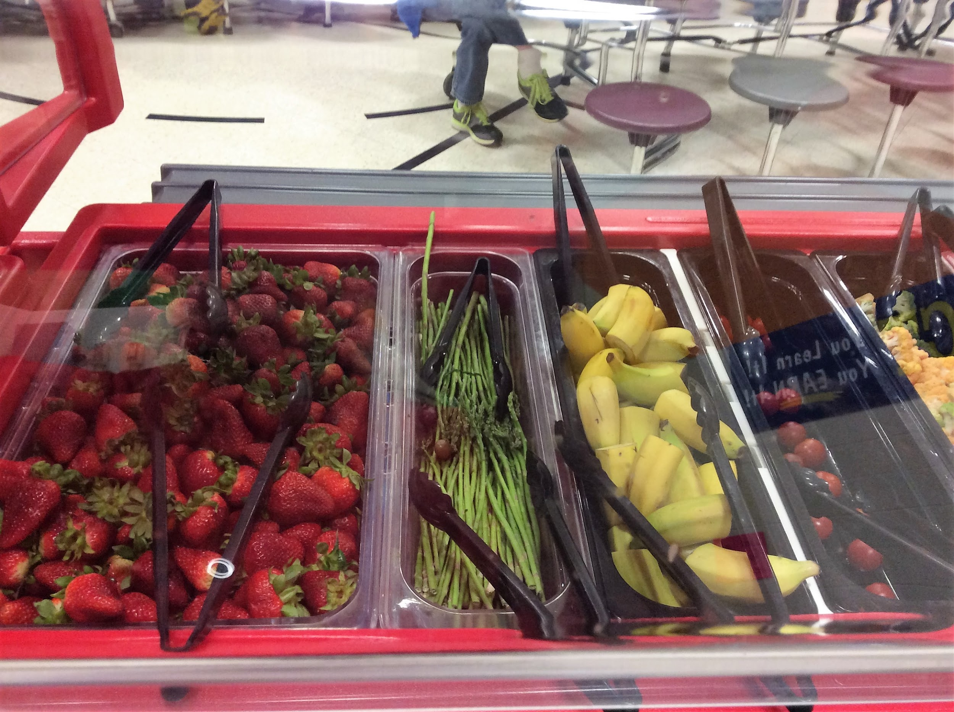
Asparagus adds dimension
Watermelon...juicy and cool

Slide 11
Variety Variety Variety

Slide 12
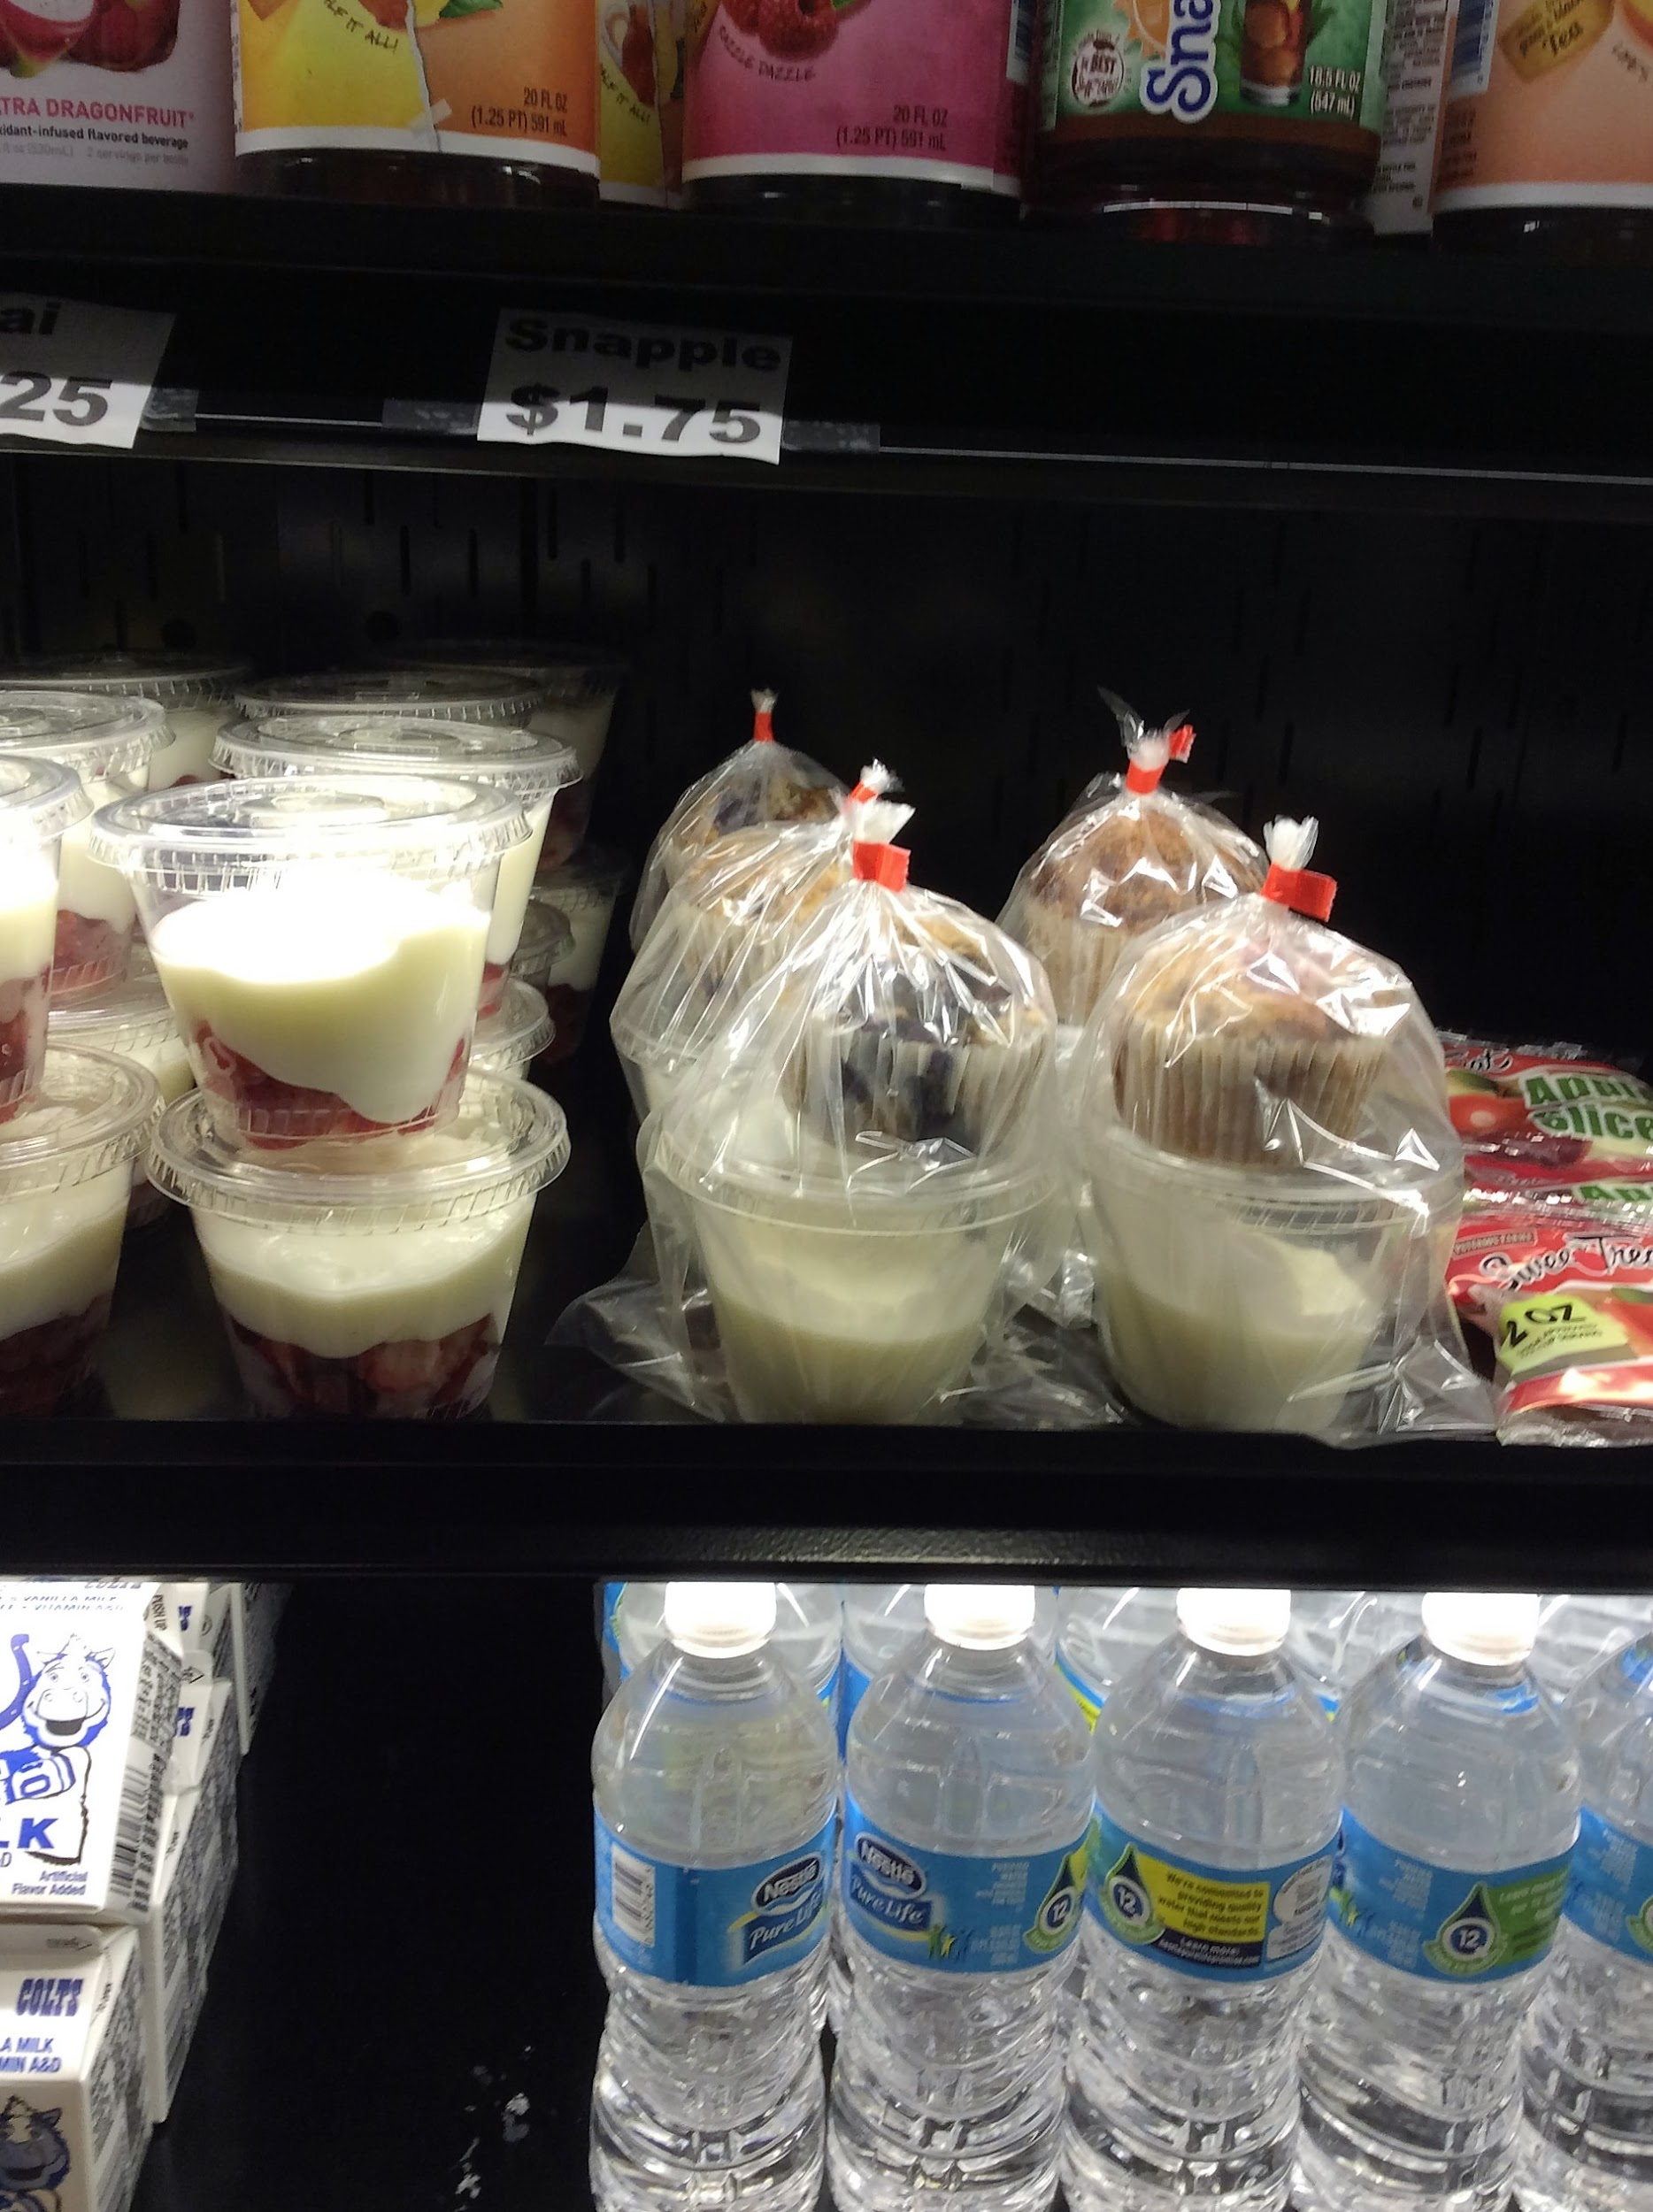
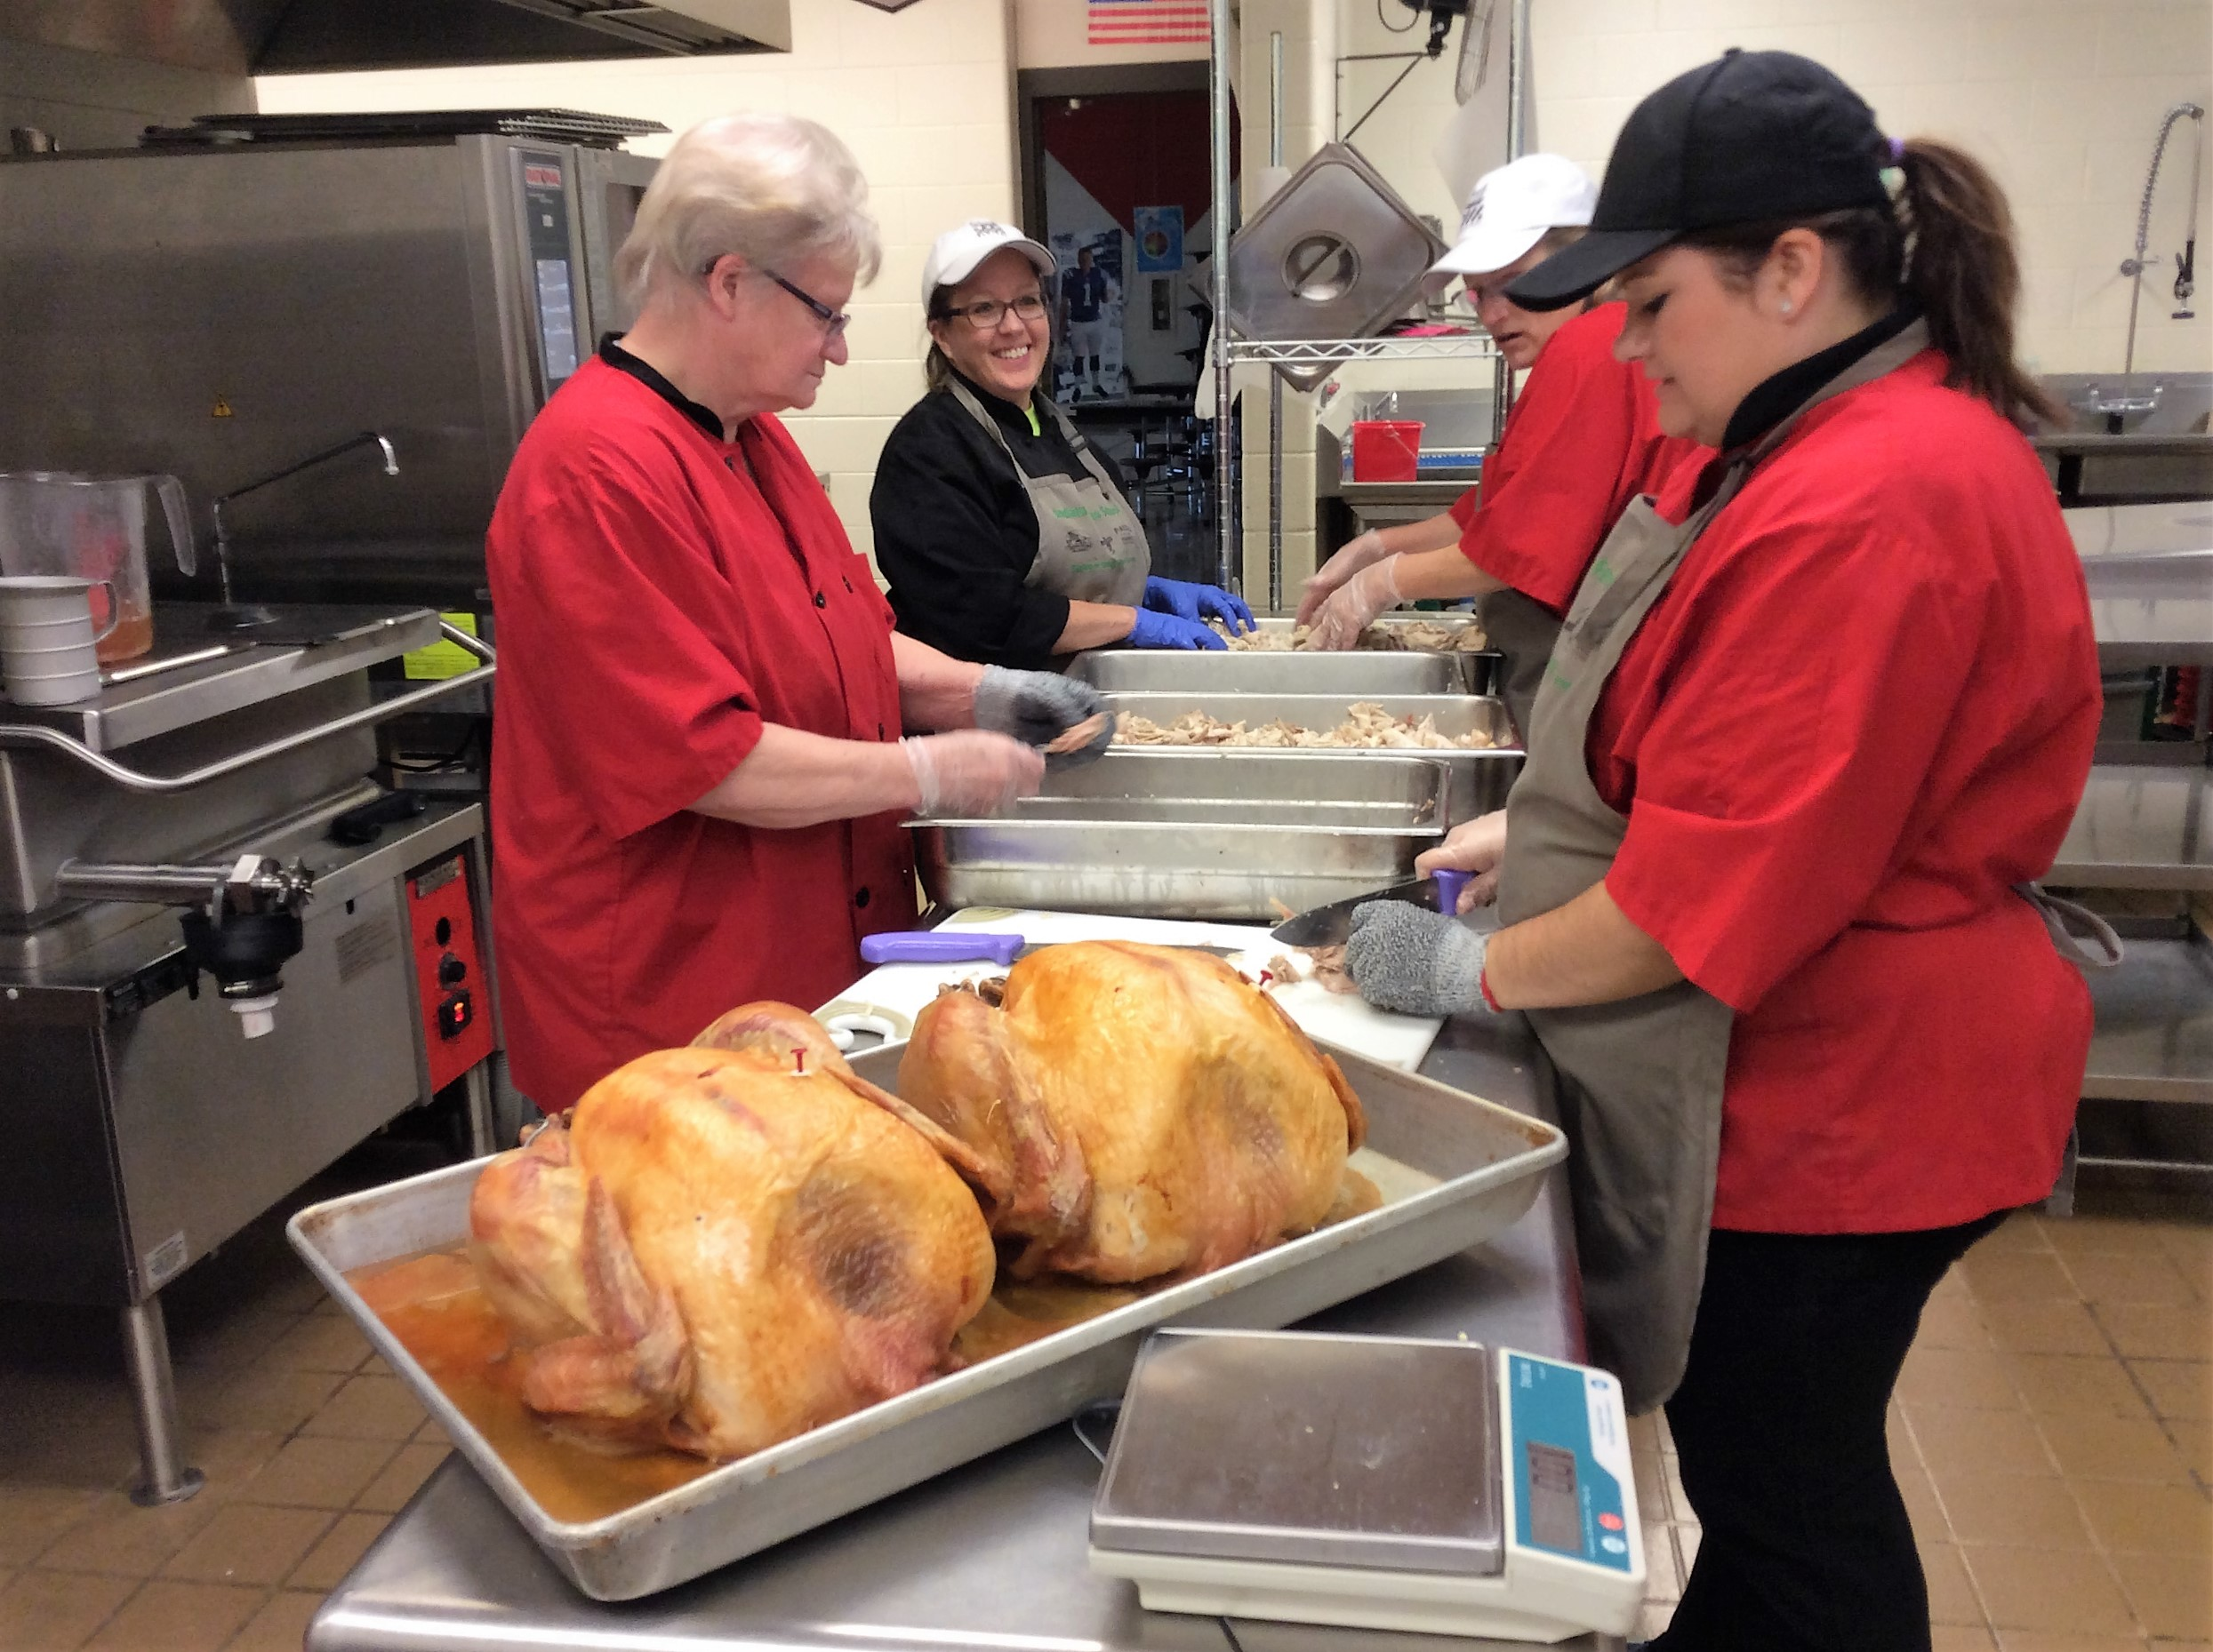
Contests/Theme Meals
FCCLA & Turkey Day

Slide 13
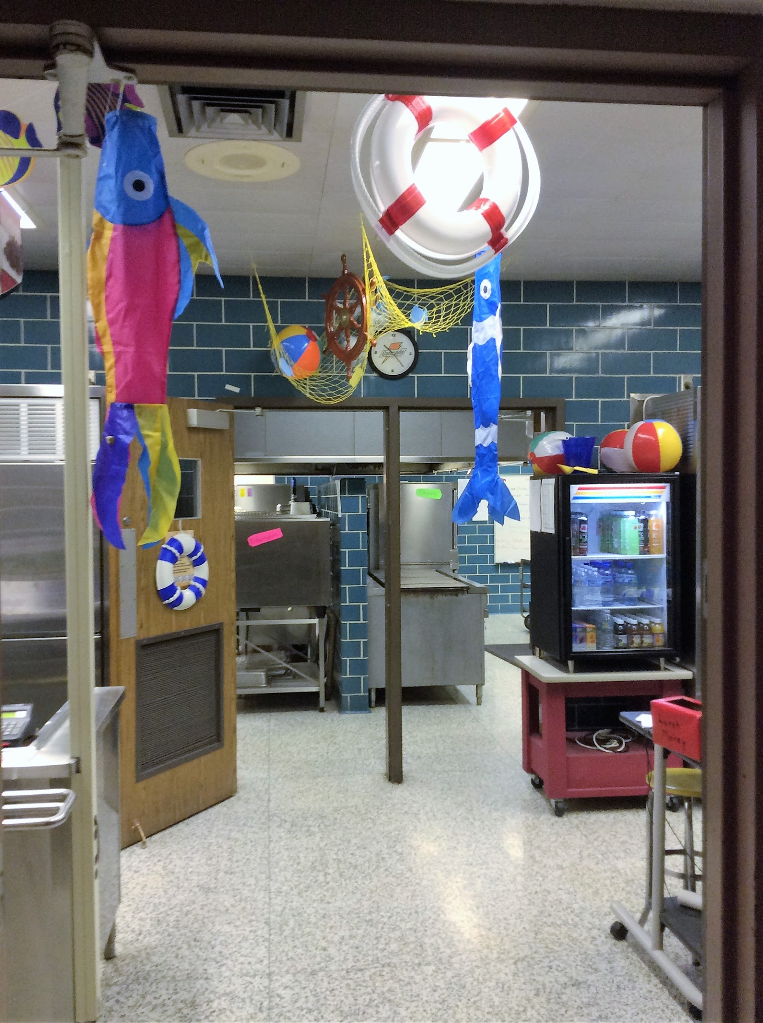
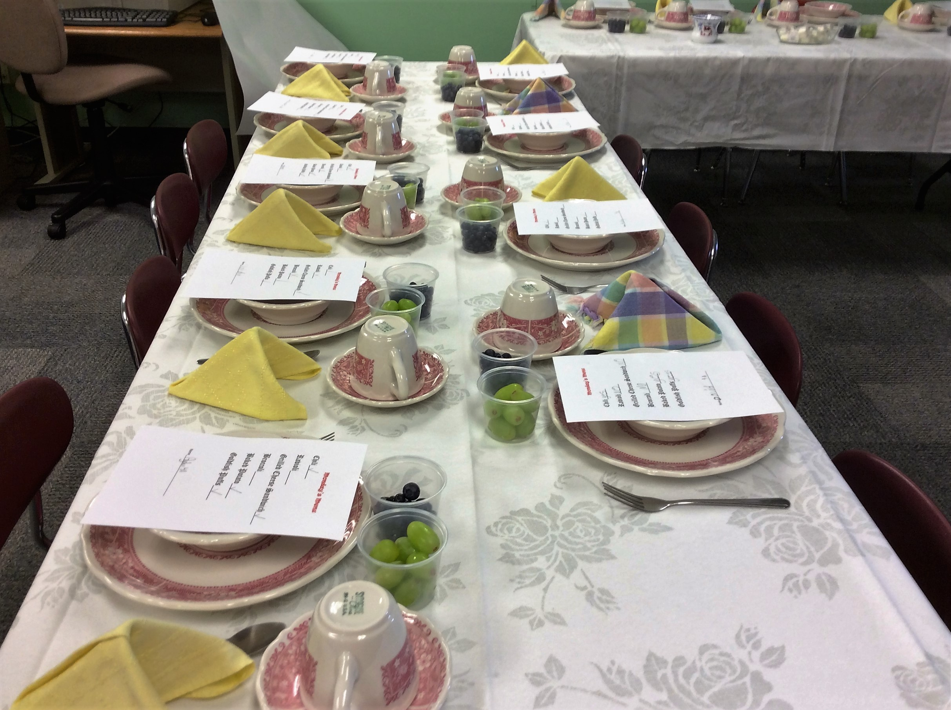
Theme Days

Slide 14
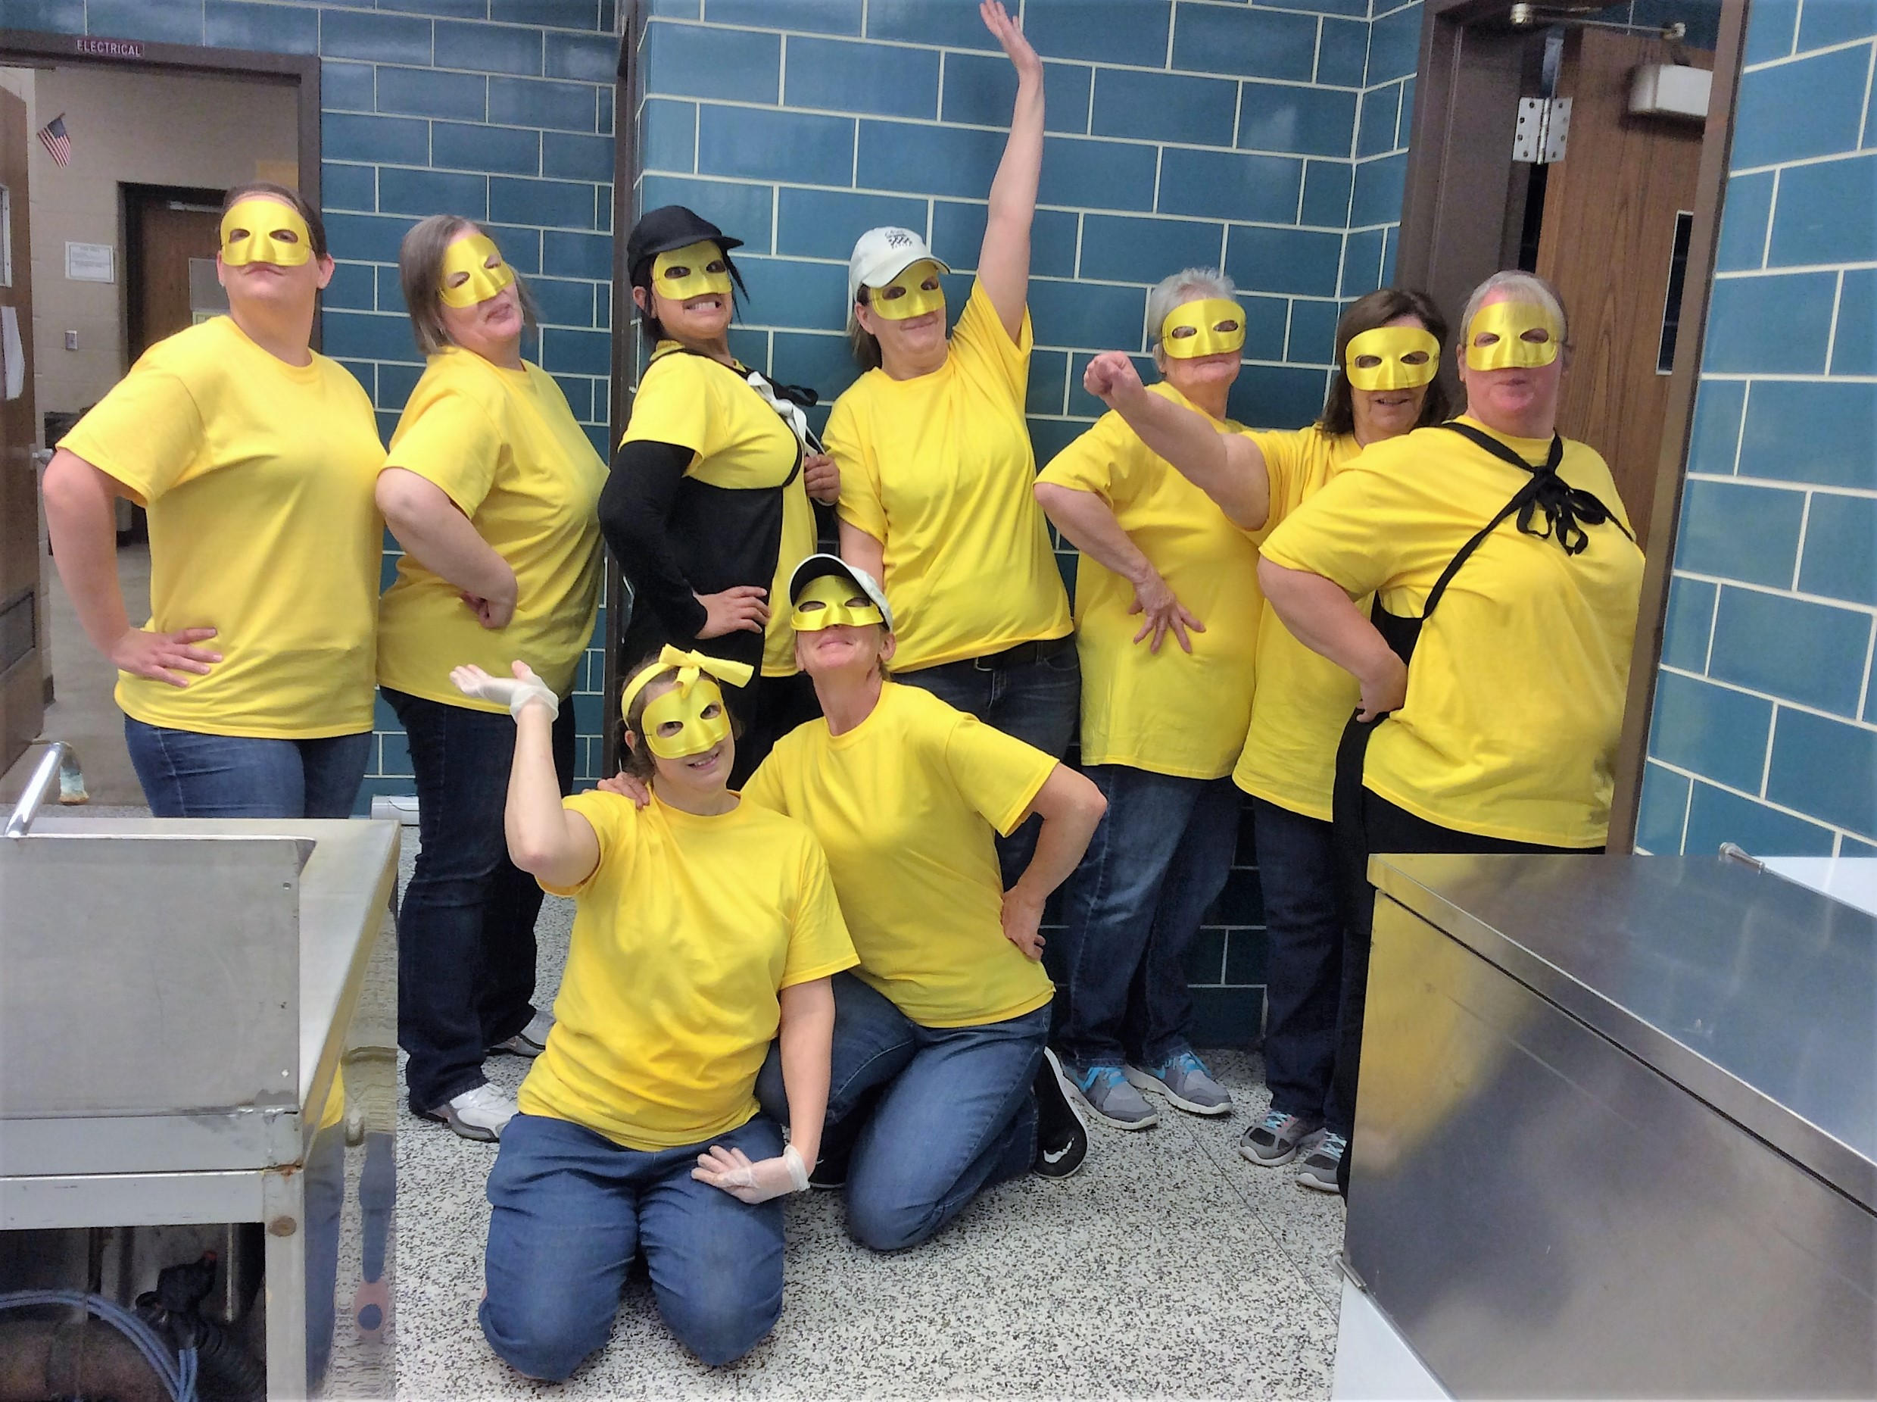
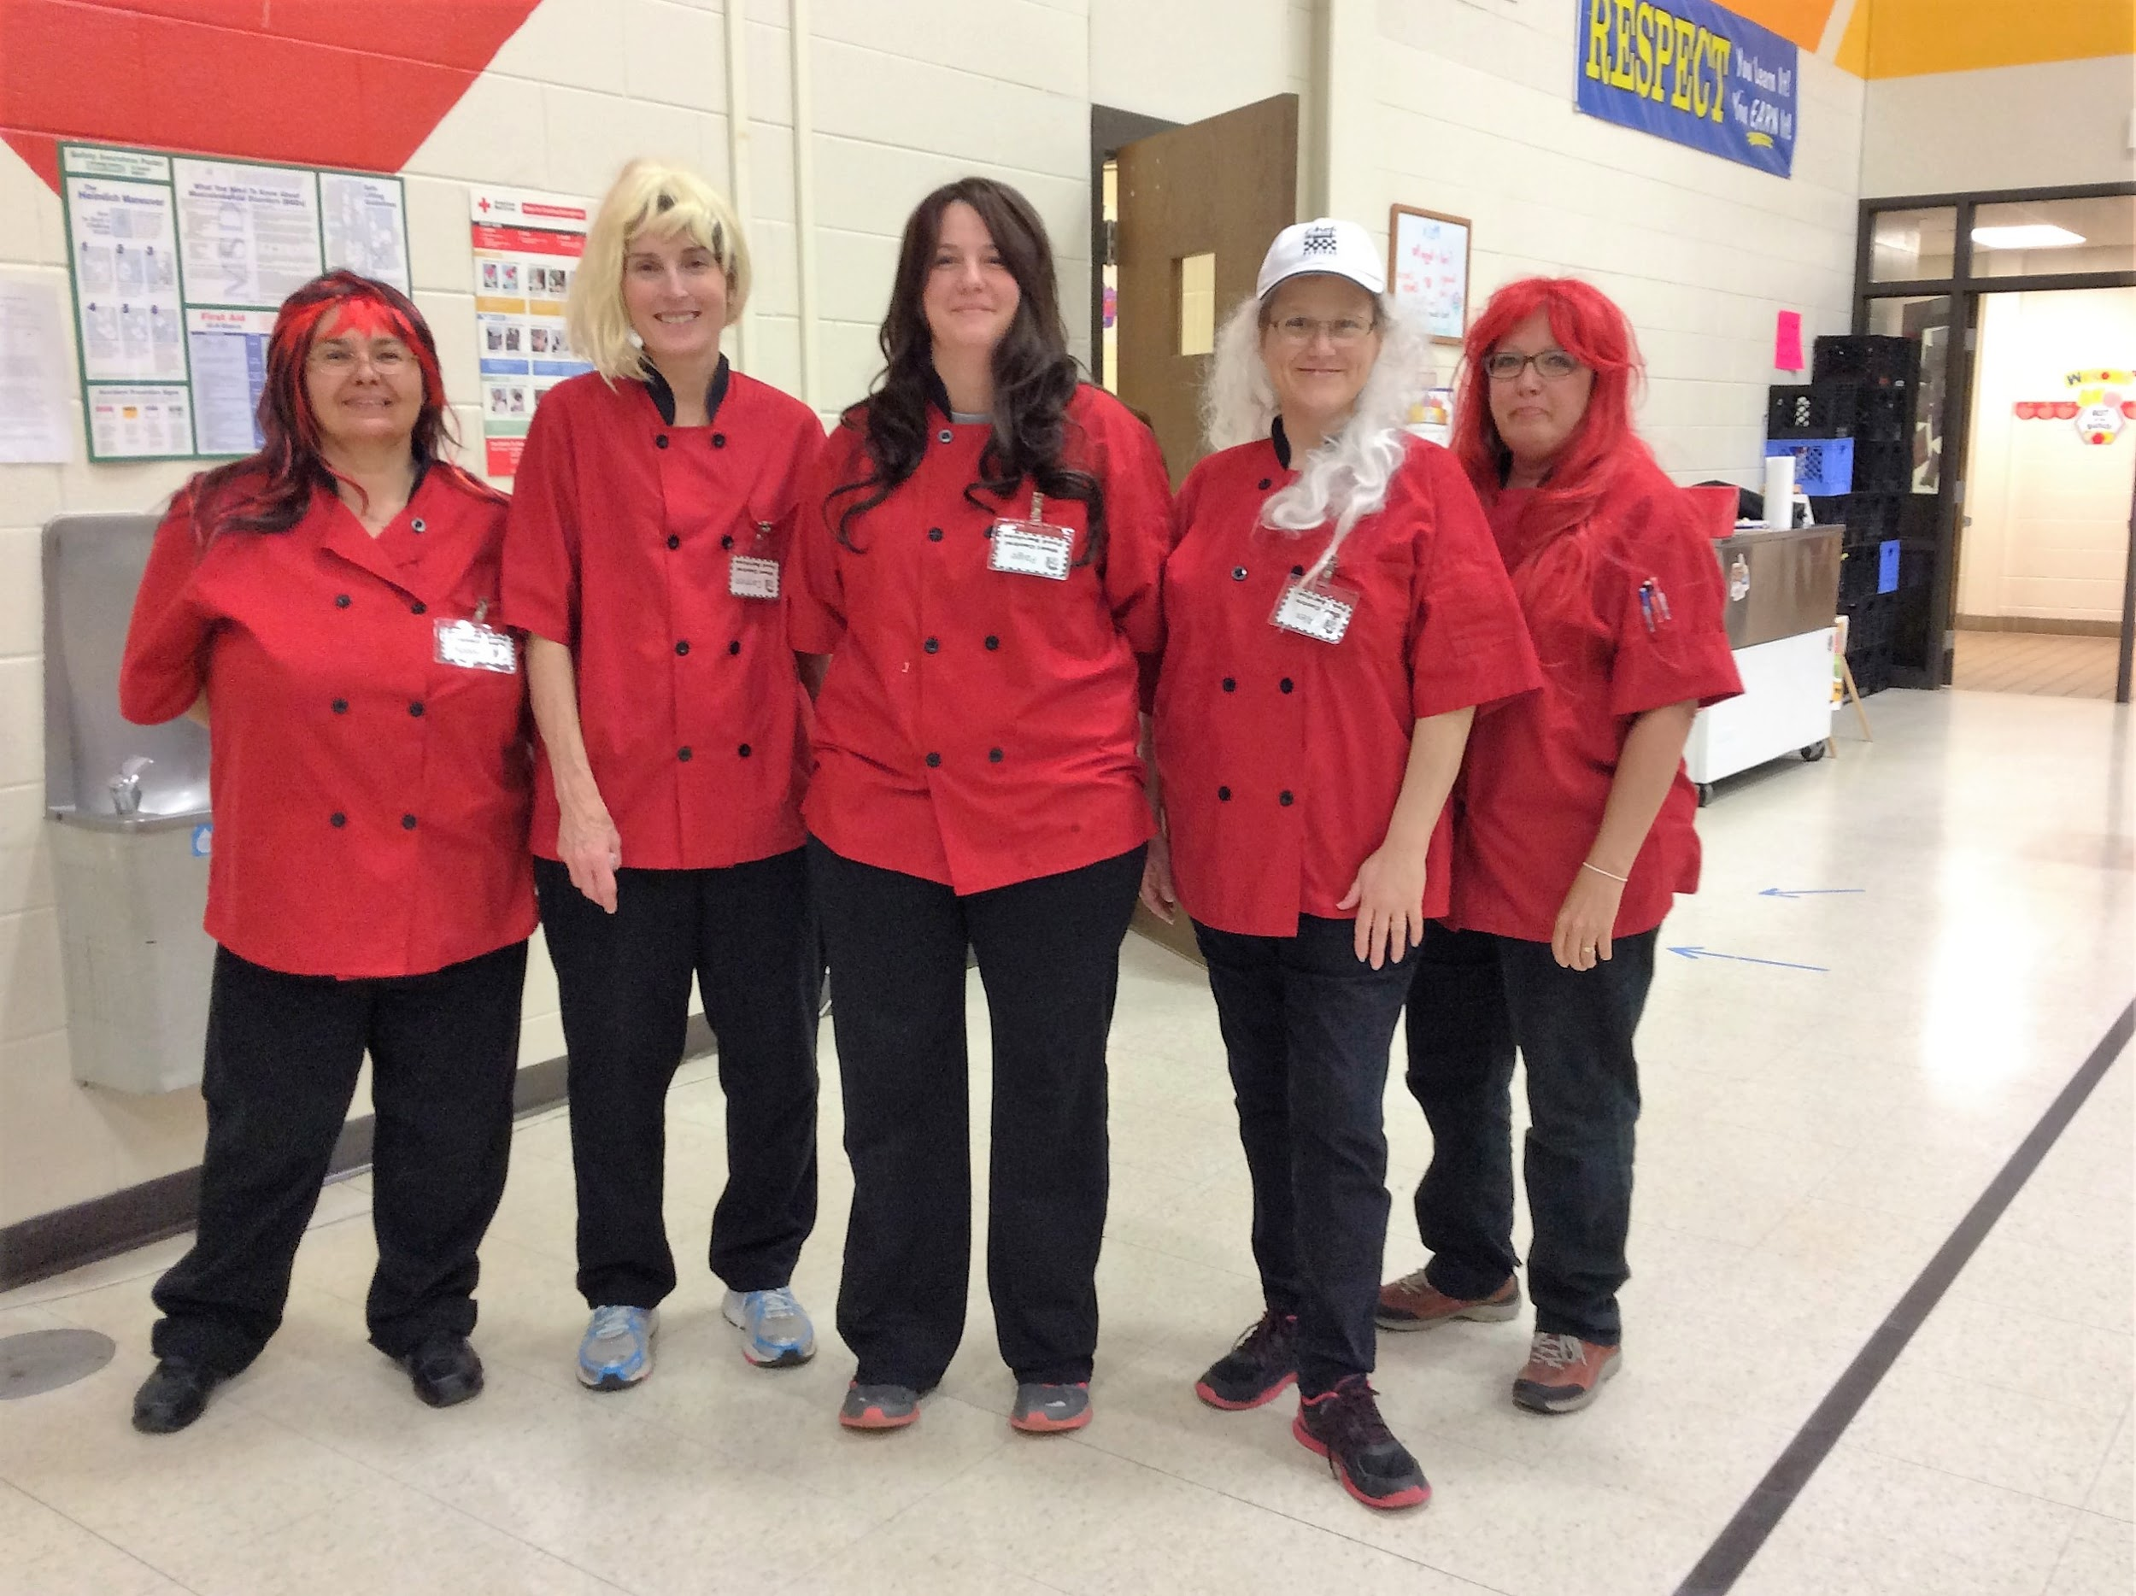
Atmosphere/Excitement/Fun
*Positive work attitude
*Super Lunch Lady Day
*Laugh and Share
*Bread rack races

Slide 15
Quotes are sometimes warnings
You never know what you may get yourself into

